Slide 1
Air Travel Insights
- By Aditya, Rohan and Sumeer

Slide 2
Business Problem Overview
Air Travel problem, flight delays that lead to financial losses, negative impact on carrier’s business reputation
The airline industry is responsible for incurring an average cost of about $11,300 per delayed flight
Figure is based on 61,000 delayed flights on a per month average and excludes costs to passengers and lost demand

Slide 3
Topics covered [Exploratory]:
Exploring whether airline carriers follow a transportation system?
Are there any patterns with respect to average departure delay, arrival delay and distance?
How does the delay change with respect to volume of flights?
How does the sentiment for various carriers look like on Twitter?
What are people discussing with respect to various airline carriers on Twitter?

Slide 4
Topics covered [Investigative]:
Investigation of hub-and-spoke transportation system using graph theory
Investigation of flight cancellations using association rule mining
Decision tree algorithms on dataset for investigating on-time performance and the factors that contribute to flight delays
Applying rpart and ctree algorithm on the dataset
SVM algorithm to focus on arrival delays in proportion with distance

Slide 5
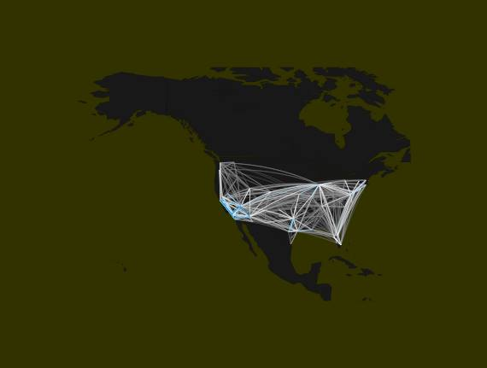
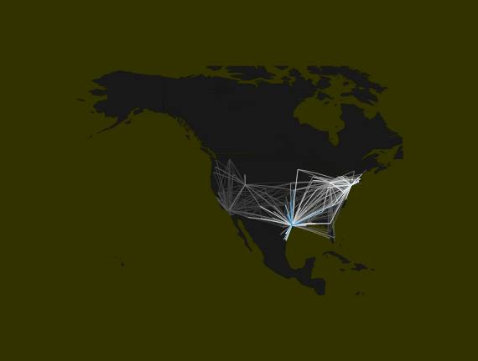
Goal: Do airline carriers follow a transportation system?
Hub: One particular airport from where most flights operate
Southwest airlines (WN) operated without a hub system, no prominent spots observed
Prominent hub system plot observed for other airline carriers
Map for Southwest airlines (WN) carrier
Map for ExpressJet Airlines (XE) carrier

Slide 6
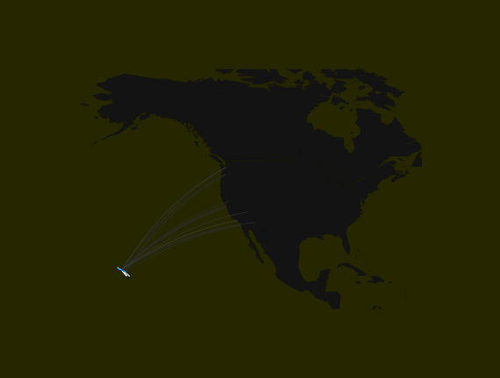
Hub-Spoke Continued
We also observed that small carriers tend to operate locally

Slide 7
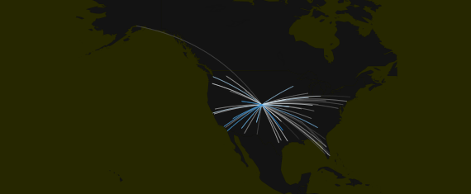
A prominent Hub System for F9

Slide 8
Goal: Investigation of hub-and-spoke transportation system using graph theory
Calculating degree, betweeness and pagerank for graph of air routes for specific carriers
What are the most popular airports for WN? How popular are they?
For southwest airlines (WN), we found
Airports | Betweenness | Degree | Pagerank
LAS | 914.7 | 112 | 0.058
MDW | 425.9 | 94 | 0.048
PHX | 319.8 | 86 | 0.043

Slide 9
Goal: Investigation of flight cancellations using association rule mining
From the dataset description, we can see that the variable `Cancelled` is categorical in nature with binary values `0` and `1` for `Not Cancelled` and `Cancelled` respectively.
We can also make a similar observation for the variable `Diverted`.
We attempt to answer questions like what would be the worst day and time to travel, such that the flight would be cancelled?
We make use of Association Mining to derive rules between factors like `Month`, `DayOfWeek`,`CRSDepTime`,`CRSArrTime`, `Origin`,`Dest`,`Distance` and various `delays` for flights operational in 2008.

Slide 10
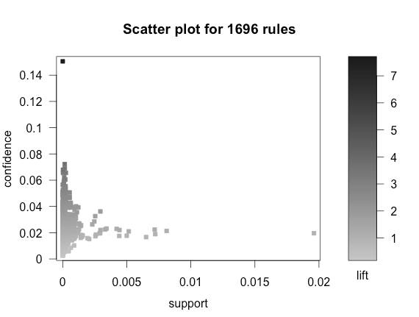
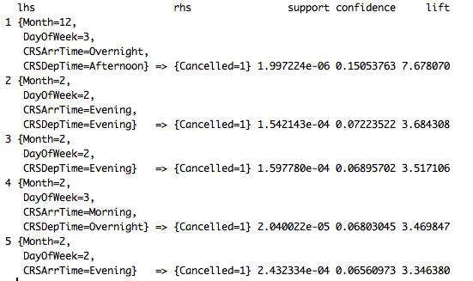
Goal: Investigation of flight cancellations using association rule mining

Slide 11
Results
Considering relatively higher value for confidence,
Avoid flight bookings in the “Month of December” for flights that take of during “Afternoon”
We also observe a significant large value for lift which means flights are getting cancelled for the mentioned Month and departure interval with a frequency higher than expected
Observations highlight that “February” also records significant cancellations for flights departing during evenings

Slide 12
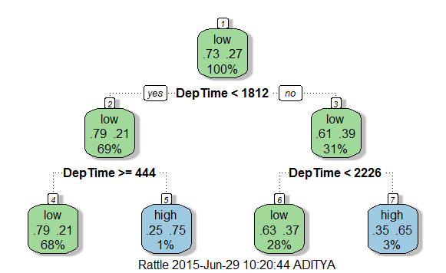
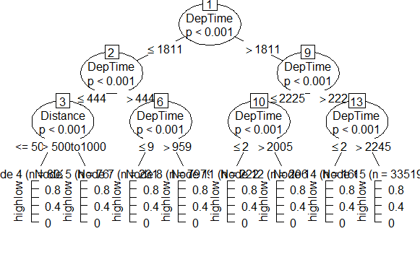
Goal: Decision tree algorithms on dataset for investigating on-time performance and the factors that contribute to flight delays
Decision Tree Fancy Plot using rpart calculation
Decision Tree Fancy Plot using ctree calculation

Slide 13
Rpart
formula3 = DepDelay ~ DayofMonth + DayOfWeek + DepTime + Distance
rpartcalculation = rpart(data = data, formula= formula3)
draw.tree(rpartcalculation, nodeinfo = TRUE)
Ctree
DepDelay
formula1 = DepDelay ~ Distance + DepTime
control1 = ctree_control(maxdepth = 3)
ctree1 = ctree(data = data, formula = formula1, control = control1)
plot(ctree1)
Arrival Delay
formula2 = ArrDelay ~ Distance + ArrTime
control2 = ctree_control(maxdepth = 3)
ctree2 = ctree(data = data, formula = formula2, control=control2)
plot(ctree2)

Slide 14
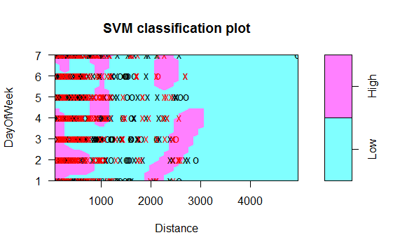
Goal: SVM algorithm to focus on arrival delays in proportion with distance

Slide 15
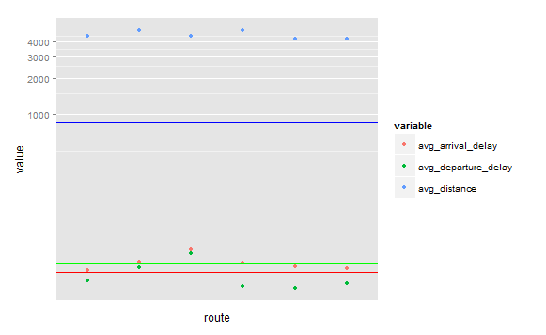
Goal: Are there any patterns with respect to average departure delay, arrival delay and distance?

Slide 16
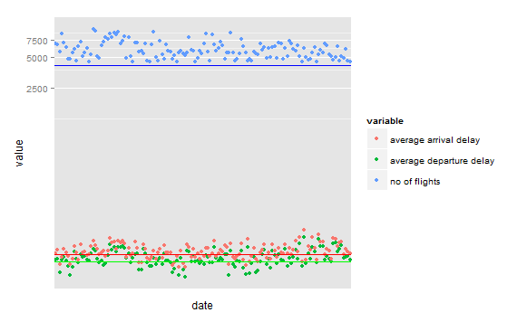
Goal: How does the delay change with respect to volume of flights?

Slide 17
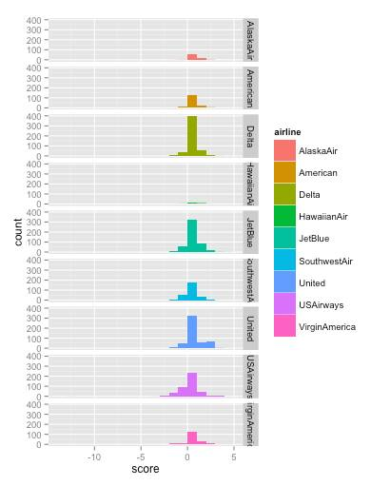
Goal: How does the sentiment for various carriers look like on Twitter?

Slide 18
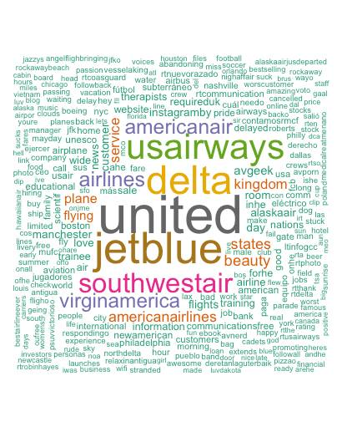
Goal: What are people discussing with respect to various airline carriers on Twitter

